Slide 1
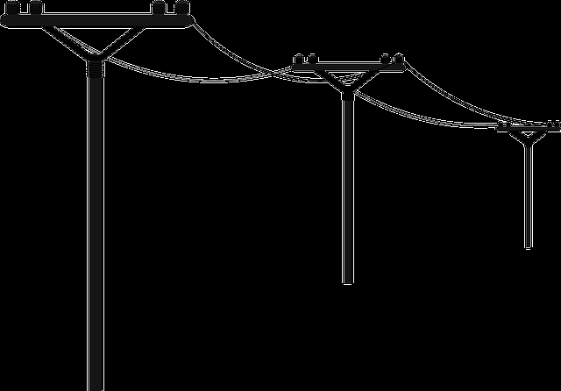
Power Flow Solver
ECEN4293 – Python with Numerical Methods
Daniel Dubon

Slide 2
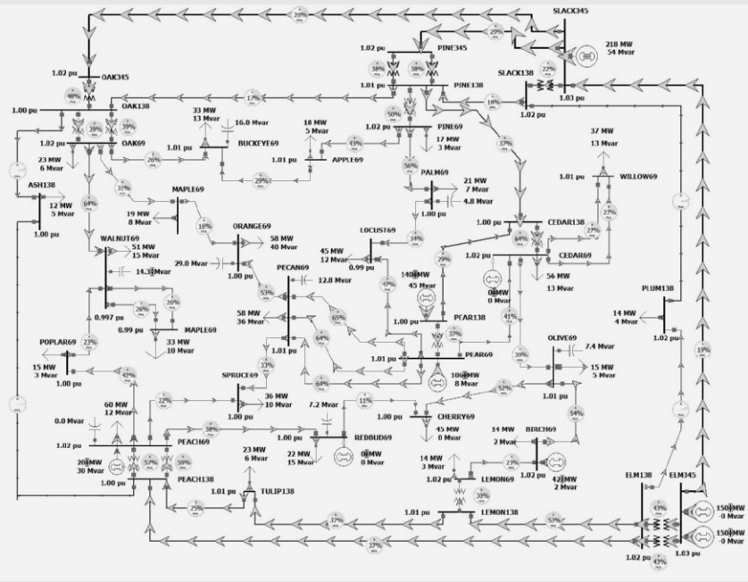
What is Power Flow Analysis?
Power flow analysis is a fundamental tool used to study power systems under balanced steady-state conditions. It calculates the voltage magnitude and angle at each bus, along with real and reactive power flows and system losses across all connected equipment.
Traditional circuit analysis methods don’t work well here because loads are specified by power (not impedance) and generators are treated as power sources. As a result, the problem is formulated as a set of nonlinear algebraic equations.
37-bus system
Notes:
It is used for both existing systems and planning future changes, such as adding new generation or transmission.

Slide 3
Newton-Raphson
Power Flow Solution by using numerical methods

Slide 4

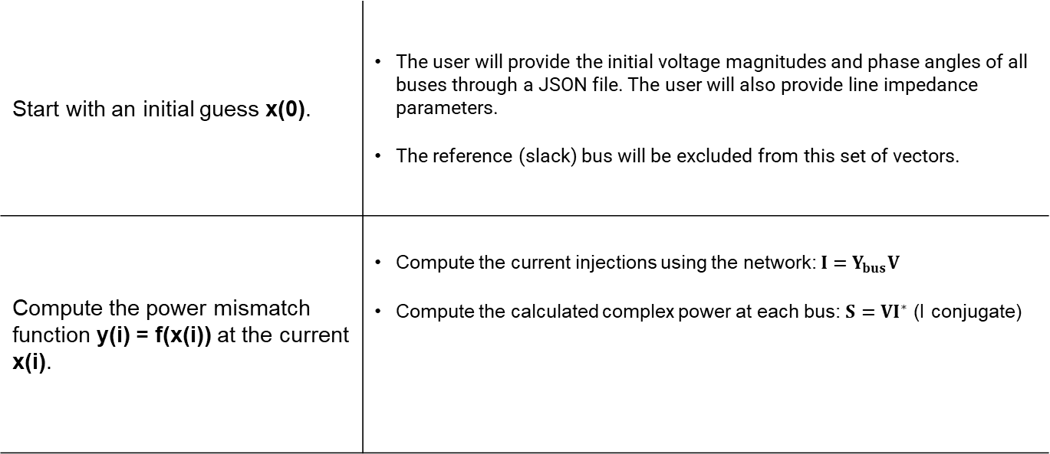
Newton-Raphson
Start with an initial guess x(0). | The user will provide the initial voltage magnitudes and phase angles of all buses through a JSON file. The user will also provide line impedance parameters. The reference (slack) bus will be excluded from this set of vectors.
Compute the power mismatch function y(i) = f(x(i)) at the current x(i). | Compute the current injections using the network: $I=Y_{bus}V$ Compute the calculated complex power at each bus: $S=VI^{∗}$ (I conjugate)
Notes:
The slack bus (bus 1) has its two most important values already fixed and known before the iteration even starts
The slack bus is a special “reference” bus with two key roles:
Angle Reference It sets the zero point for all phase angles in the system. All other bus angles (δ) are measured relative to the slack bus angle of 0°. This makes the math consistent.
Power Balancer It supplies (or absorbs) whatever real power (P) and reactive power (Q) is left over after all other generators and loads are accounted for. → After Newton-Raphson converges, the program calculates how much power the slack bus must provide (this is the “Slack: P=10.403 MW, Q=92.537 MVAr” you see in your report). This automatically balances the entire system, including losses.
Compute the current injections using the network: $I=Y_{bus}V$
What it represents: It completely describes the electrical connections of the entire network (every line’s resistance, reactance, and shunt elements are packed into this one matrix).
How it works in the solver: Ybus is built once at the beginning (before the Newton-Raphson loop starts) from the branch data. It never changes during the iterations. It is used in every iteration to compute currents from voltages

Slide 5
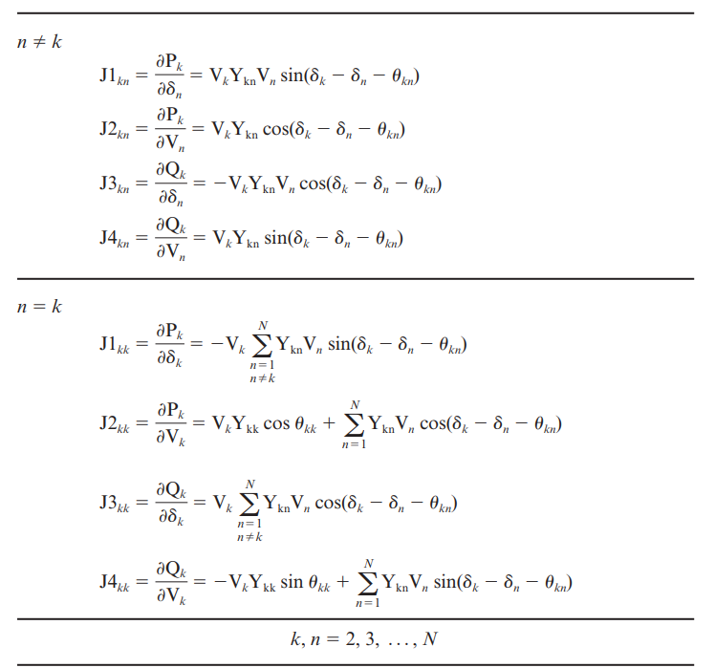
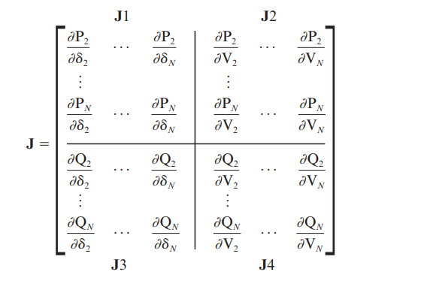
Newton-Raphson
Compute the Jacobian matrix. | The partial derivatives describe how real and reactive power vary with changes in voltage magnitude and phase angle.
Notes:
When n=k diagonal components

Slide 6

Newton-Raphson
Solve the linear system to obtain the correction vector Δx(i). | Use Gauss Elimination + back substitution or Levenberg-Marquardt algorithm?
Update unknown variables.
Check the mismatch | If the maximum value in Δy(i) < tolerance, then the solution has converged.
Notes:
In real power-flow problems the Jacobian J is frequently ill-conditioned (nearly singular). This happens because:
The system can be heavily loaded.
Voltage magnitudes are close to 1.0 p.u. while angles are small.
Some lines have very high or very low R/X ratios.
During early iterations the linear approximation can be poor.
When J is ill-conditioned:
Direct Gauss elimination can produce huge rounding errors.
The correction dx can become unrealistically large.
The iteration diverges or crashes (NaN/Inf).
Main Reasons Levenberg-Marquardt is better for power flow:
Handles ill-conditioned Jacobian In power systems, the Jacobian matrix J often becomes nearly singular (especially near heavy loading or during initial iterations). Plain Gauss elimination amplifies numerical errors badly. Levenberg-Marquardt adds a small positive number (lambda * I) to the diagonal, making the matrix always invertible and well-behaved.
Prevents divergence Pure Newton can overshoot dramatically when the initial guess is not great. Levenberg-Marquardt automatically reduces the step size when needed, making corrections more conservative and safer.
Combines the best of two worlds When close to the solution → λ is small → behaves almost exactly like classic Newton-Raphson (very fast quadratic convergence). When far from the solution → λ becomes larger → acts more like a stable gradient-descent step.

Slide 7
Program Structure

Slide 8
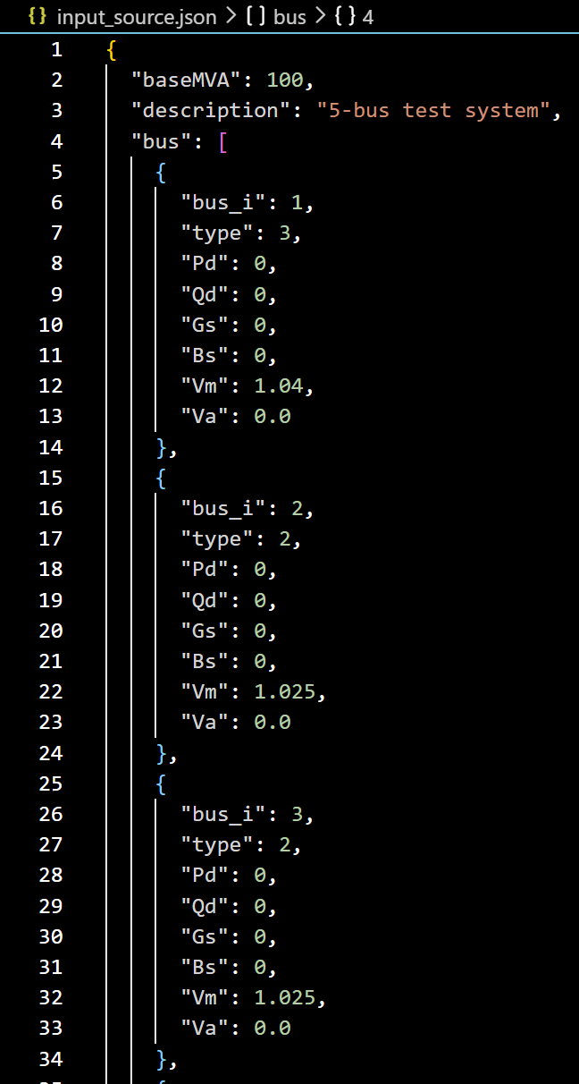
Input File

Slide 9
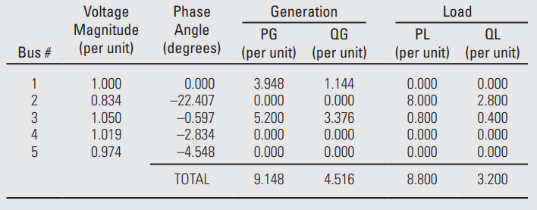
Desired Program Output

Slide 10
Fin

